Slide 1
The Greedy method

Slide 2
Greedy Method: Introduction
Different problems require the use of different kinds of techniques.
Some commonly-used techniques are:
  Divide and conquer
  Randomized algorithms
  Greedy Method
  Dynamic programming
Greedy method is technique to solve similar kinds of problems.
A Greedy method always makes the choice that seems to be the best at that moment.

Slide 3
Greedy Method: Introduction
Greedy Method is:
  Simplest and straightforward approach.
  Approach in which the decision is taken on the basis of current available information without worrying about effect on the future.
  Mainly used to solve optimization problems.
  Easy to implement and quite efficient in most of the cases.
  An algorithmic paradigm that follows local optimal choice at each step with the hope of finding global optimal solution.

Slide 4
Components of Greedy Method
Feasible solution−
    A solution/subset that satisfies some constraints is called as feasible solution.
Objective function −
    Used to assign a value to a solution or a partial solution.
Optimal Solution-
    Feasible solution that maximizes or minimizes objective function is called optimal solution.
A selection function −
    Used to choose best input to be added to the solution.
A solution function −
    Indicate whether a complete solution has been reached.

Slide 5
Greedy Method: Area of Application
Finding shortest path
Finding minimum spanning tree
Job Sequencing with deadline
Knapsack problem
Huffman coding

Slide 6
Knapsack problem
The knapsack problem is consider as container or bag.
For Knapsack
Given a set of n objects.
Knapsack/bag with capacity m.
Each object i has weight Wi and a value/profit Pi.
Put these items in a knapsack of capacity m to get the maximum total value in the knapsack
The objective is-
  To fill the knapsack with items such that we have a maximum profit without crossing the weight limit of the knapsack.
Determine number of each item to include in a knapsack so that
  Total weight is less than or equal to a capacity of knapsack
  The total value/profit is as large as possible.

Slide 7
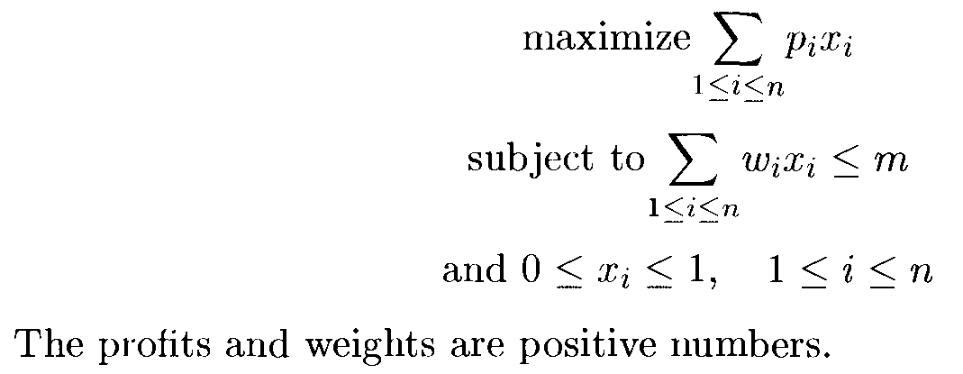
Knapsack problem
In Fractional Knapsack, we can break items to maximize the total value/profit of the knapsack
Fraction Xi is placed into knapsack to earn profit of PiXi.
Each Xi such that, 0<=Xi<=1,
Feasible solution is any set (x1,x2,…….xn), satisfying knapsack condition.
Problem can be stated as-

Slide 8
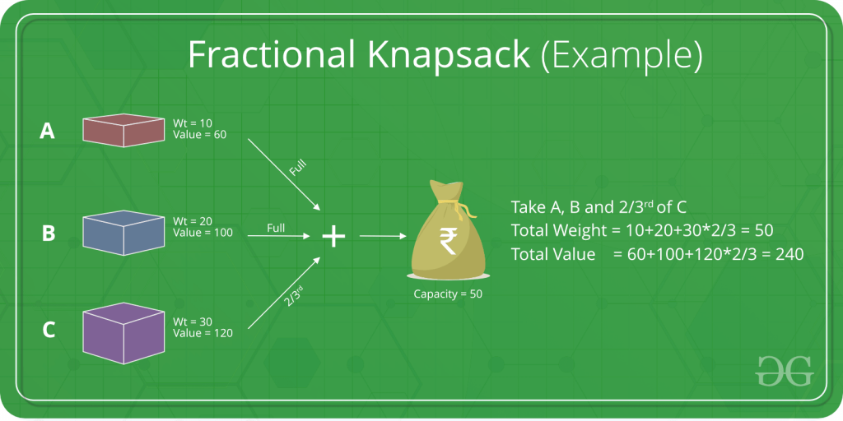
Knapsack problem Example

Slide 9
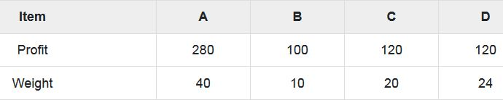
Example
Consider knapsack with capacity m = 60 and the list of items. Find set of items which gives maximum profit.

Slide 10
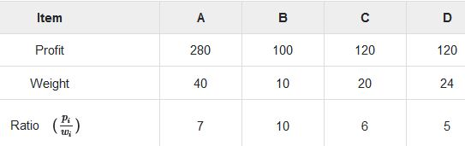
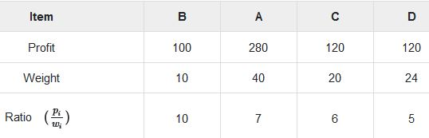
Solution
Find the ratio Pi/Wi for each item
Items are sorted as descending based on ratio pi/wi.

Slide 11
First add items B to the knapsack. → W=10 < m=60
Next, item A is added to knapsack. → W=40 < m=10
Now, C is chosen → W=20 > m=10
Add fraction of C to fill knapsack as (60 − 50)/20)= 10
Capacity of Knapsack is equal to the selected items.
Hence, no more item can be selected.
The total weight of the selected items is
10 + 40 + 20 * (10/20) = 60
Total profit is
100 + 280 + 120 * (10/20) = 380 + 60 = 440
Set of items is { A+B+(1/2)*C } selected for getting maximum profit with given weight.

Slide 12
Example
Item i | 1 | 2 | 3 | 4
Profit P | 100 | 20 | 60 | 40
Weight w | 3 | 2 | 4 | 1
Solution:
Total items n = 4
Total capacity of the knapsack m = 5
Find maximum profit by adding items with limited weight.

Slide 13
Dynamic Programming
The General Method
  It is used to obtain the optimal solution.
  It is one which break the problems into series of overlapping sub-problems.
  It would solve the all sub-problems and then select one that would lead to an optimal solution.
  It generally considers all possible cases/solutions and then choose the best.
  Dynamic Programming is generally slower.
  It works based on principle of optimality.

Slide 14
Dynamic Programming
It is algorithmic technique which is usually based on recurrent formula that uses some previously calculated states.
It may consider the previous state.
It follows bottom up or top down strategy by synthesizing them from smaller optimal sub solutions.
It requires table for memorization and it increases it’s memory complexity.
Is takes decision at every stage.
It is more efficient.
Examples- Optimal binary search trees
-0/1 Knapsack
-Traveling Sales person problem

Slide 15
Optimal Binary Search Tree (Optimal BST)
In binary search tree,
  The nodes in the left subtree have lesser value than root node and nodes in the right subtree have greater value than root node.
BST has
  key values of each node in the tree, and
  frequencies of each node in terms of searching (how much time is required to search a node).
The frequency and key-value determine the overall cost of searching a node in BST.

Slide 16
Construct a binary search tree of all keys such that the total cost of all the searches is minimum.
The time required to search a node in BST is more than balanced binary search tree. (balanced BST contains a less number of levels than BST)
There is one way that can reduce the cost of a binary search tree is known as an optimal binary search tree.
An optimal binary search tree is-
  A binary search tree for which the nodes are arranged on levels such that tree cost is minimum.

Slide 17
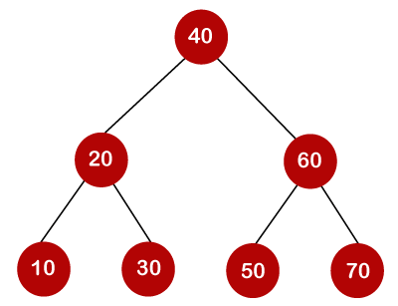
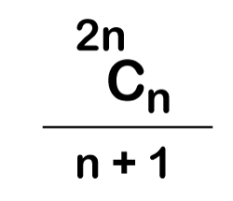
Example
If keys/nodes are 10, 20, 30, 40, 50, 60, 70
Binary search tree is
Number of BST is calculating from the given number of keys by using formula,

Slide 18
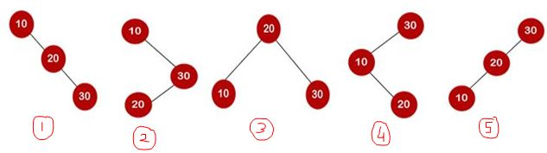
Example:
Consider 10, 20, 30 are the keys, find Optimal BST.
Solution-
Total 5 number of BST can be created from keys.
5 binary search trees are-

Slide 19
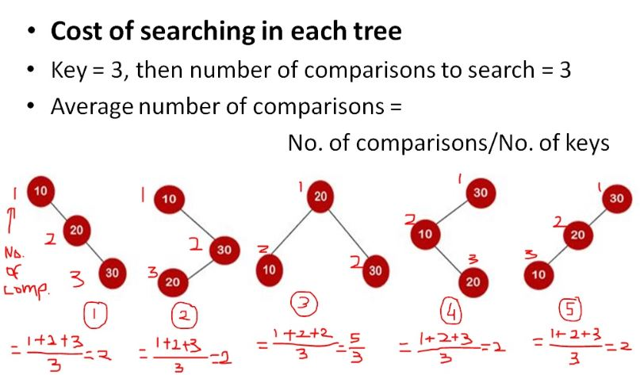
Minimum number of average no of comparison = 5/3

Slide 20
How to find optimal binary search tree
To find optimal binary search tree, determine the frequency of searching a key.
frequencies associated with keys 10, 20, 30 are 3, 2, 5.
Keys 10 20 30
Frequency 3 2 5
Solution
Find all possible binary search tree
Find BST with minimum cost is called as Optimal BST.
First, find cost of each node and then cost of BST.
Cost of each node=
frequency * no. of comparisons (node level)

Slide 21
10, 20, 30 are the keys.
Total 5 number of BST can be created from keys.
5 binary search trees are-
Cost of each node=
frequency * no. of comparisons (node level)

Slide 22
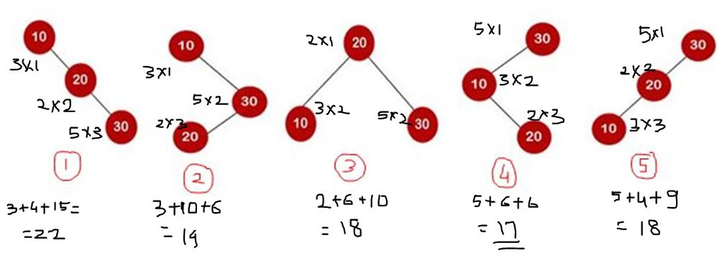
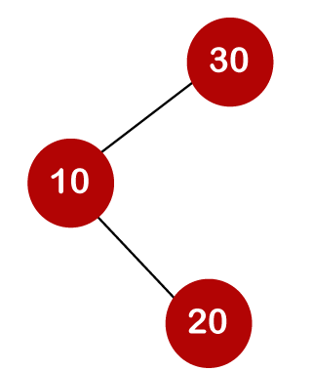
Organization of tree 4 gives optimal binary search tree.
Optimal BST for keys 10,20,30 is

Slide 23
End of Unit 5

